Slide 1
ECHO BOARD
By:
Nishant Sahay

Slide 2
ABSTRACT
The recent trend in technology has given rise a whole new world of digital voice assistants(DVA) viz. Siri, Google assistant and Alexa. These devices can be used to perform and automate tasks like booking tickets, playing songs and setting alarms. With the simultaneous rapid rise of Internet of things and the fact that these devices are cloud based makes it a match made in heaven for these devices to be used for IoT application. One such application where DVAs can be employed is voice and remote control of switch & plug boards. With technology as a brush and our human mind as a canvas, this project aims at painting the picture for a future where switch boards can be controlled with voice when in vicinity and with mobile application over the internet when very far apart. The projects aim at creating a 8 channel switch board which can be controlled with voice and app , along with features of group controlling of switches and time scheduling for reducing power consumption and safety

Slide 3
What is it?
It is an 8 channel switch board that can be controlled over voice commands through Alexa.

Slide 4
REVIEW OF LITERATURE
Lifx Color 1000: Lifx's second-gen smart bulbs are brighter and more efficient. It has an easy-to-use app, the integrations with IFTTT and Alexa, and the fact that Lifx bulbs don't need a hub is also an advantage.
IKEA Smart Lighting Project: The Ikea TRÅDFRI skill for Alexa is also live in countries where Amazon is selling Echo devices. After enabling it, owners can ask Alexa to dim their Ikea bulbs, or turn them on and off. But it is not compatible with other IoT devices.
Amazon Smart Plug works with Alexa to add voice control to any electrical socket. Schedule lights, coffee machines and appliances to turn on and off automatically, or control them remotely. Its hard to integrate with existing system & costly
TP-Link KASA Smart Power Strip: Instead of one smart plug, why not get a smart power strip that lets you plug in and independently control up to six different devices using Alexa or Google Assistant! You get proper surge protection built in along with three USB ports for charging even more devices.

Slide 5
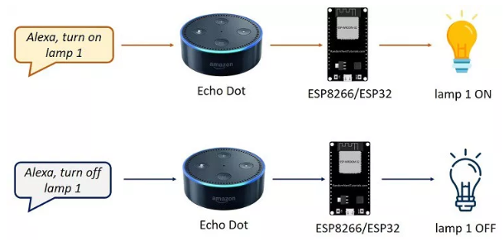
Problem Statement
To control devices through voice commands by using Alexa & NodeMCU

Slide 6
Purpose & Requirement
Purpose : A voice & mobile app controlled switch board to which various devices can be plugged in.
Behavior : The switch board should be able to turn off and on various plugs. It can be be either controlled through voice or mobile application
System Management Requirement : The system should provide remote monitoring and control functions.
Application Deployment Requirement : The application should be deployed locally on the device, but should be accessible remotely.
Security Requirement : The system should have basic user authentication capability.

Slide 7
Features
A 8 channel switch board which can be controlled through voice by using Alexa Echo Dot
The switches can be controlled individually as well as in a group
The board can be controlled by a mobile app over the internet for remote switching on and off
The switches on the board are reconfigurable and can be renamed according to the user’s preference
Time scheduling to keep a switch on for a specified duration of time

Slide 8
Design methodology

Slide 9
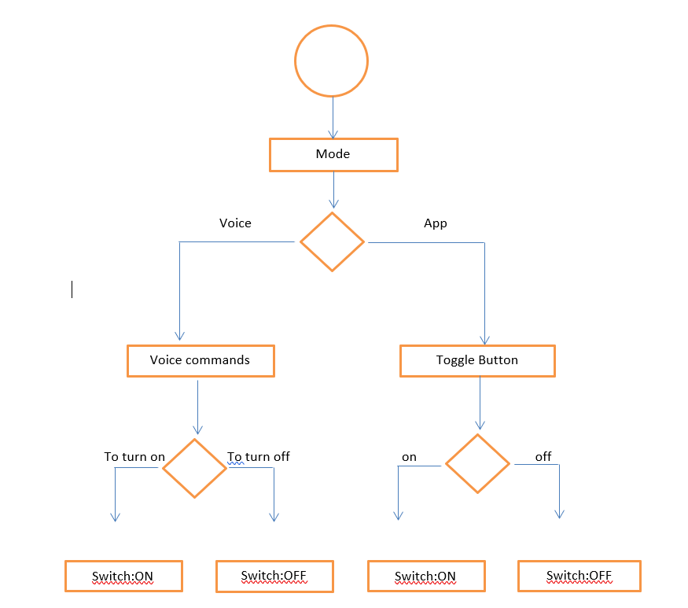
Process level specification
The switch can be controlled in two ways i.e. mode. The two modes are voice control and mobile app.
In voice control, the user gives voice commands to Alexa echo dot.
If the voice command is to turn a switch on, it switches it on and if its to turn off, its switches off
In the mobile app, the interface has toggle button to set the switch state
If the button is toggled to on, its switches on and if its toggled to off, it will switch off the switch
This flowchart represents the methodology for a single switch. Same flow is present for all switches and can be replicated
Process level specification of a switch

Slide 10
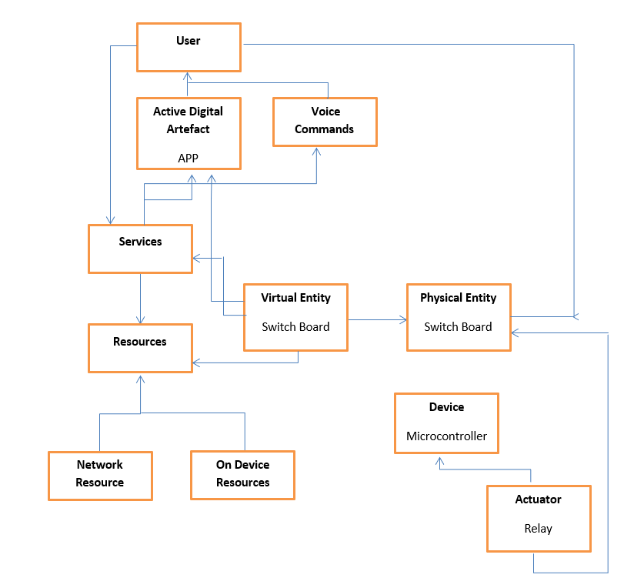
Domain level specification

Slide 11
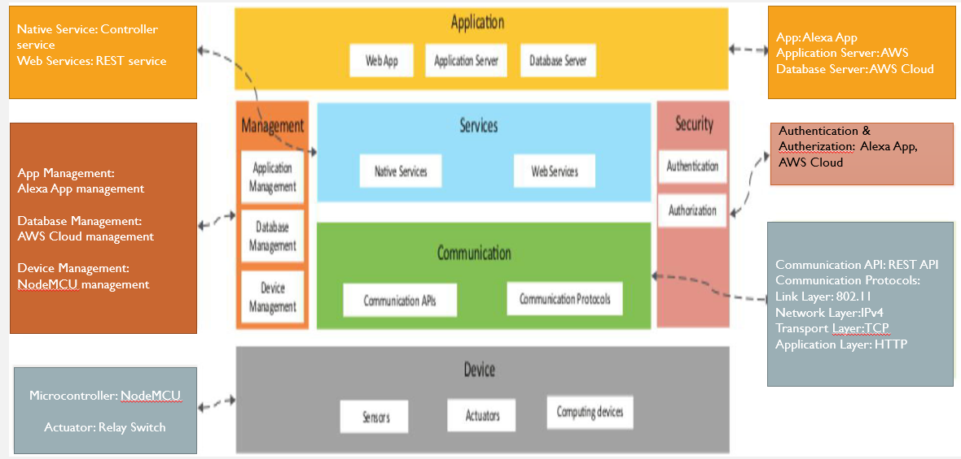
OPERATIONAL VIEW SPECIFICATION
Various options pertaining to the IoT system deployment and operation are defined, such as, service hosting options, storage options, device options, application hosting options, etc.

Slide 12
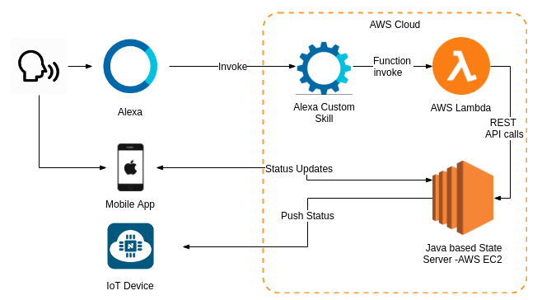
Solution Design Overview:

Slide 13
INVOKING CUSTOM SKILL
Alexa, Turn On Cloud server and Switch 2
Alexa: Wake word
Turn On: Invocation name
Cloud server: Slot
And: connecting word
Switch 2: Slot
{ “state”: “on”, “switches”:[2, 3,5]
}
JSON representation

Slide 14
Components & Devices
Name | Description | Specifications
NodeMCU | NodeMCU is an open source IoT platform. It includes firmware which runs on the ESP8266 Wi-Fi SoC from Espressif Systems, and hardware which is based on the ESP-12 module.. It is based on the eLua project, and built on the Espressif. | USB – micro USB port for power & programming 15-pin header with access to GPIOs Power – 5V via USB
Amazon Echo Dot 3rd Generation | Amazon Echo Dot is the latest addition to Amazon's Echo line of cylindrical voice-controlled computing devices that connect to the AVS for providing response | Voice interaction Music Playback .
8 Channel Relay | A Relay is an electrically operated switch. Many relays use an electromagnet to mechanically operate the switch and provide electrical isolation between two circuits. | This 8 channel 5V relay has both optical and magnetic isolation, providing a lot of protection to the inputs from electrical faults on the outputs..

Slide 15
Why NodeMCU?
Parameters | Arduino Uno | Raspberry Pi B+ | NodeMCU
Processor | ATMega328P | Quad-core ARM Cortex A53 | -
GPU | - | Broadcom VideoCore IV with 400 | -
 |  | MHz
Operating voltage | 5V | 5V | 3.3V
Clock speed | 16 MHz | 1.2GHz | 26 MHz – 52 MHz
System memory | 2kB | 1 GB | <45kB
Flash memory | 32 kB | - | up to 128MB
EEPROM | 1 kB | - | -
Communication | IEEE 802.11 b/g/n IEEE | IEEE 802.11 b/g/n IEEE 802.15.4 | IEEE 802.11 b/g/n
supported | 802.15.4 433RF BLE 4.0 via | 433RF BLE 4.0Ethernet Serial
 | Shield
Development | Arduino IDE | Any linux compatible IDE | Arduino IDE, Lua Loader
environments
Programming | Wiring | Python C C++ Java Scratch Ruby | Wiring, C, C++
language
I/O Connectivity | SPI I2C UART GPIO | SPI DSI UART SDIOCSI GPIO | UART, GPIO
Parameters | Arduino Uno | Raspberry Pi B+ | ESP-8266
Processor | ATMega328P | Quad-core ARM Cortex A53 | -
GPU | - | Broadcom VideoCore IV with 400 | -
 |  | MHz

Slide 16
Start
Headset Worn? i.e. Proximity Sensor State
Far
Near
Switch on IR LED to capture image in dark
Switch on camera module & capture iris image
Send the pic to location of web server running on Rpi, Turn off LEDs
Iris image can be downloaded from web server link

Slide 17
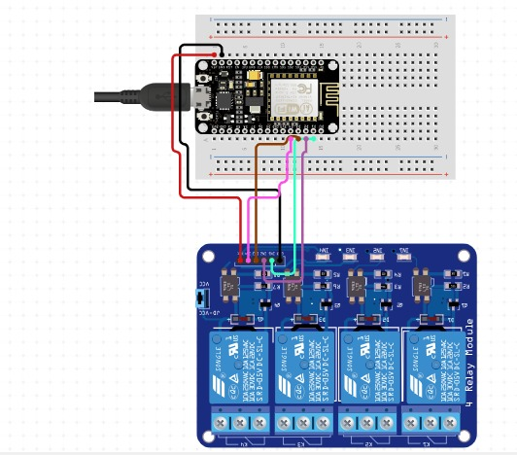
Circuit Diagram

Slide 18
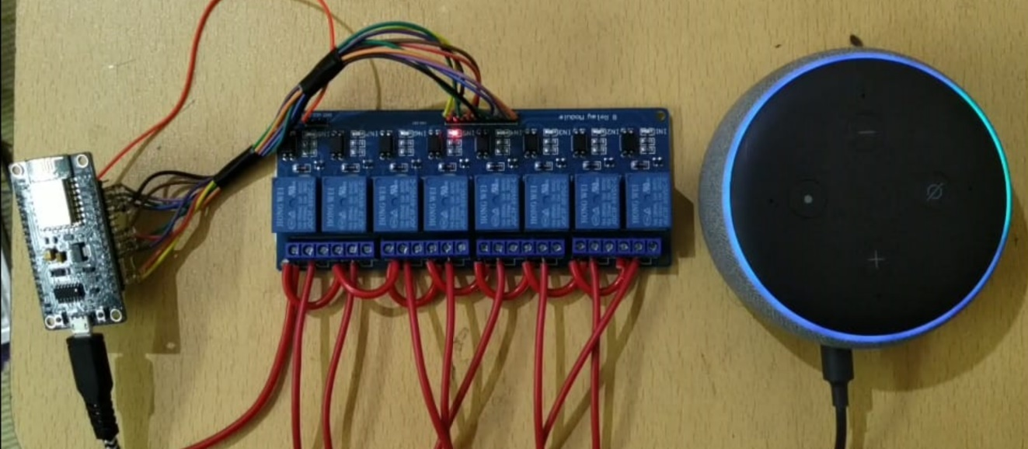
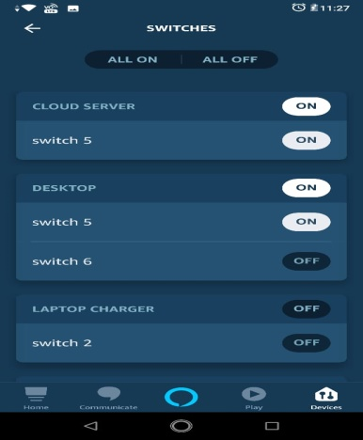
RESULTS
8 channel Freedom Control
Mobile App Control
Switching Individual channel
Mobile app

Slide 19
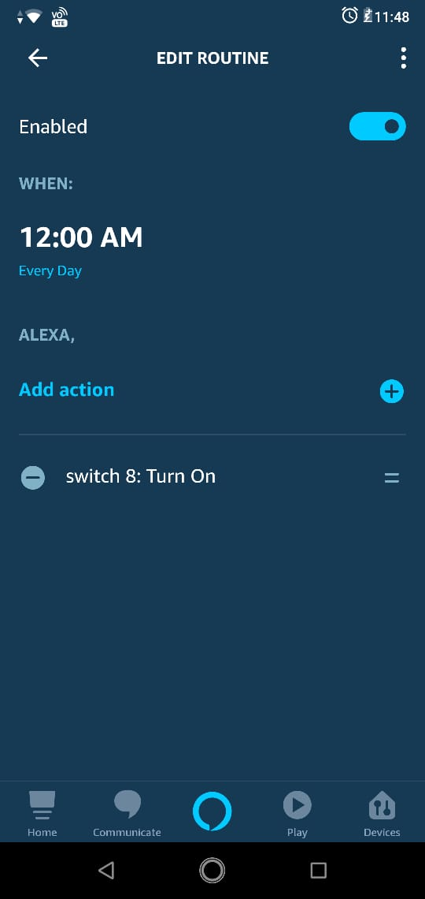
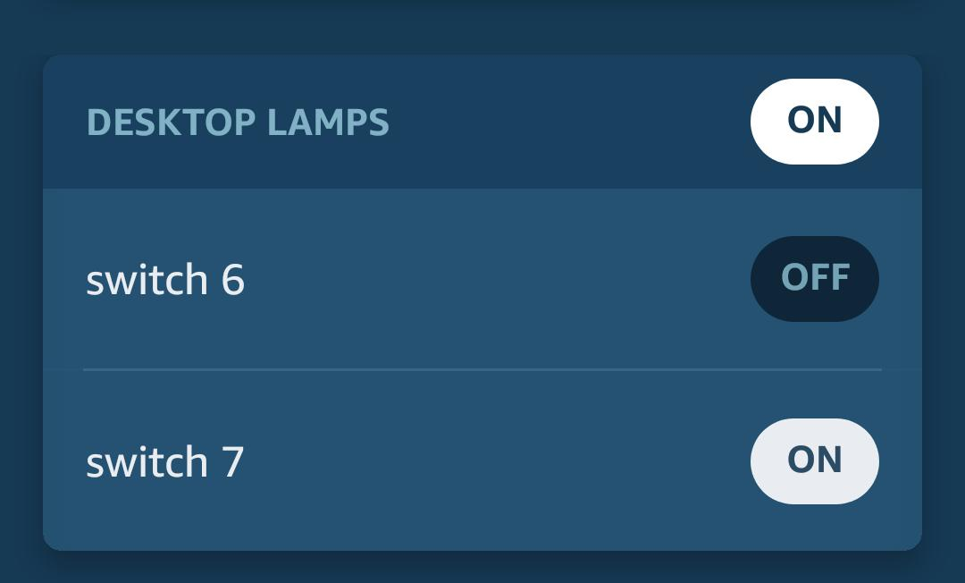
results
Time scheduling
Group Control
Time scheduling for switch 8
Desktop lamp group

Slide 20
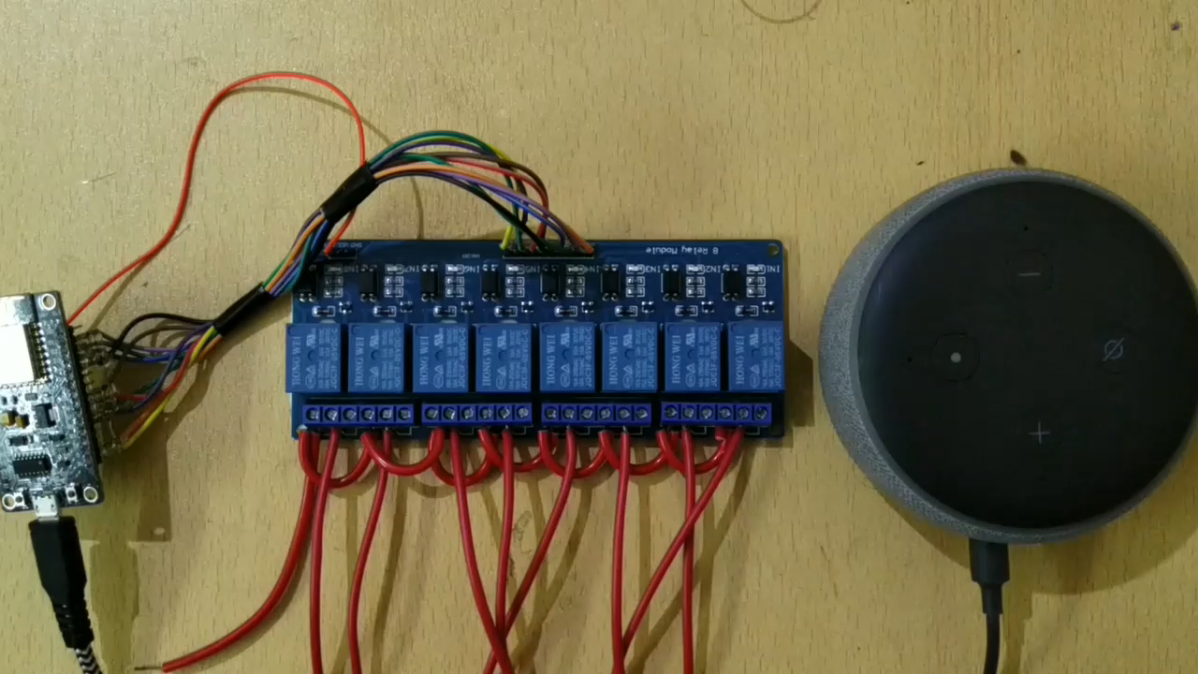
DEMONSTRATION VIDEO

Slide 21
APPLICATIONs
It can be used in sync with home automation as a house has many switches and plugs.
This project is a boon for visually impaired and physically challenged people, for whom it is inconvenient to perform the task of switching on or off of plugs.
It can be used to control switches in industrial units, where the switch boards are located at inaccessible locations. Since the project can control the switches remotely through voice and app, it can conveniently used
It can be used in offices where a supervisor is in charge of electrical switches. This project will give a centralized hub to control and monitor the switches in an institution
The scheduling option, which offers to switch on a plug for a specified time can prove to be very crucial for saving power consumption.
The scheduling option can also be used in scenarios with time constraints. For example, it can be used to turn on a computer being used for exam for a specified amount of time
The project makes it easier for monitoring and finding faults if any in the switch system of a place, particularly the ones with huge number of switches, since all the switches are either numbered or have names, which makes it easier to finding faults.

Slide 22
ADVANTAGES
The project can monitor the state of switches and with scheduling, it can be a precursor for reducing the power consumptions
Remote switching of plug offers safety and protection in case there is any
The switches and groups can be named according to the user’s choice and convenience.
It is easy to scale up the device since adding new board would only require relays and a microcontroller. The same app and alexa echo dot can handle the scaled-up versions
The system is easy to integrate since it’s a stand-alone device and can be employed for home, office and industrial use
Compared to the products present in the market , this system is cheaper.

Slide 23
LIMITATIONS
The system is can be compromised by physical access or theft
The Alexa voice service is susceptible to relay attacks
The commands for voice control are only in English language, which can be a hassle for non-English speaking users.

Slide 24
FUTURE SCOPE
Compatibility with other digital voice assistants.
Improved security and voice recognition capability
Integration of voice control with vernacular languages

Slide 26
REFERENCES
Prof B.P Kulkarni, Aniket V Joshi, Vaibhav V Jadhav, Akshaykumar T Dhamange, “IoT Based Home Automation Using Raspberry PI”, International Journal of Innovative Studies in Sciences and Engineering Technology, Vol. 3 Issue 4 April 2017.
J.Chandramohan, R.Nagarajan, K.Satheeshkumar, N.Ajithkumar, P.A.Gopinath, S.Ranjithkumar6, “Intelligent Smart Home Automation and Security System Using Arduino and Wi-fi”, International Journal Of Engineering And Computer Science, Vol. 6 Issue 3 March 2017
Tatjana Eric, Sandra Ivanovic, Suncica Milivojsa, “Voice control for smart home automation: Evaluation of approaches and possible architectures”, Internet of Things Journal IEEE, Sept 2017
Kalyani Pampattiwar, Mit Lakhani, Rinisha Marar and Rhea Menon, “Home Automation using Raspberry Pi controlled via an Android Application”, International Journal of Current Engineering and Technology, 2017
Shivani V Devoor, Syed Sha Qutub & Mallikarjuna Swamy M.S ,”Design of Sensor Network for Home Automation System”, International Journal of Engineering and Innovation technology,2015
N. Sriskanthan and Tan Karand. “Bluetooth Based Home Automation System”,Journal of Microprocessors and Microsystems, Vol. 26, pp.281-289, 2002.
Arduino IDE- Home: https://www.arduino.cc/en/guide/environment
ESP8266 Community Forum: http://www.esp8266.com/
. Kumar, M., and Shimi, S. L. “Voice Recognition Based Home Automation System for Paralyzed People System”, Vol. 4, No. 10, 2015
Arshdeep Bahga , Vijay Madisetti, “Internet of Things (A Hands-on-Approach)”, Publisher: Vijay Madisetti , 12th September 2014.

Slide 27
Thank you

